Slide 1
AI- POWERED DEVELOPER DASHBOARD
G.HASINI-2420030421
G.KEERTANA-2420090075
S.RISHITHA-2420090060
1

Slide 2
Problem Statement
HR teams need a centralized platform to manage employee information and onboarding activities.
Task allocation should consider employee skills, workload, experience, and current work state.
Onboarding progress must be visible and easy to track.
Employee well-being information can support better workload and task decisions.
Managers need a single dashboard to monitor employees, tasks, onboarding, and mood information.
2

Slide 3
Objectives
Centralize employee and HR-related information.
Manage tasks, priorities, deadlines, and employee assignments.
Provide structured onboarding steps and progress tracking.
Collect employee mood, energy, stress, focus, and motivation data.
Provide task suggestions using employee skills, workload, experience, and mood.
Offer an interactive HR assistant chatbot for common dashboard queries.
3

Slide 4
Proposed System
Employee Management
Employee profiles, roles, skills, experience, workload and onboarding status.
Task Management
Create, prioritize, assign and monitor development/work tasks.
Onboarding
Track HR and technical onboarding steps with progress.
Mood & Well-being
Record energy, stress, focus, motivation and mood score.
Smart Matching
Suggest suitable employees for tasks using project data.
HR Assistant
Chatbot for tasks, mood, onboarding, workload and deadlines.
4

Slide 5
Project Design
Problem Framing — Defined pain point (assignment ignores skill, capacity, mood) + success criteria
Requirements & Domain Modeling — Identified 5 core entities + scoring rules
Data Design — Schema for Employee, Task, WorkLog, MoodSurvey, OnboardingStep
Algorithm Design — Mood formula + 4-signal ranker (skill 40 / capacity 25 / experience 15 / mood 20)
System Architecture — React SPA → Flask API → logic → ORM → SQLite
API Design — Froze all endpoints before coding
Frontend Design — Wireframed 5 views + chatbot widget
Validation Design — Unit checks, scenario tests, explainability review, <60s gate
Build & Integrate — Assembled into one runnable app
Test & Iterate — Verified mood changes reorder tasks live
Document & Ship — README, brief, technical soundness
5

Slide 6
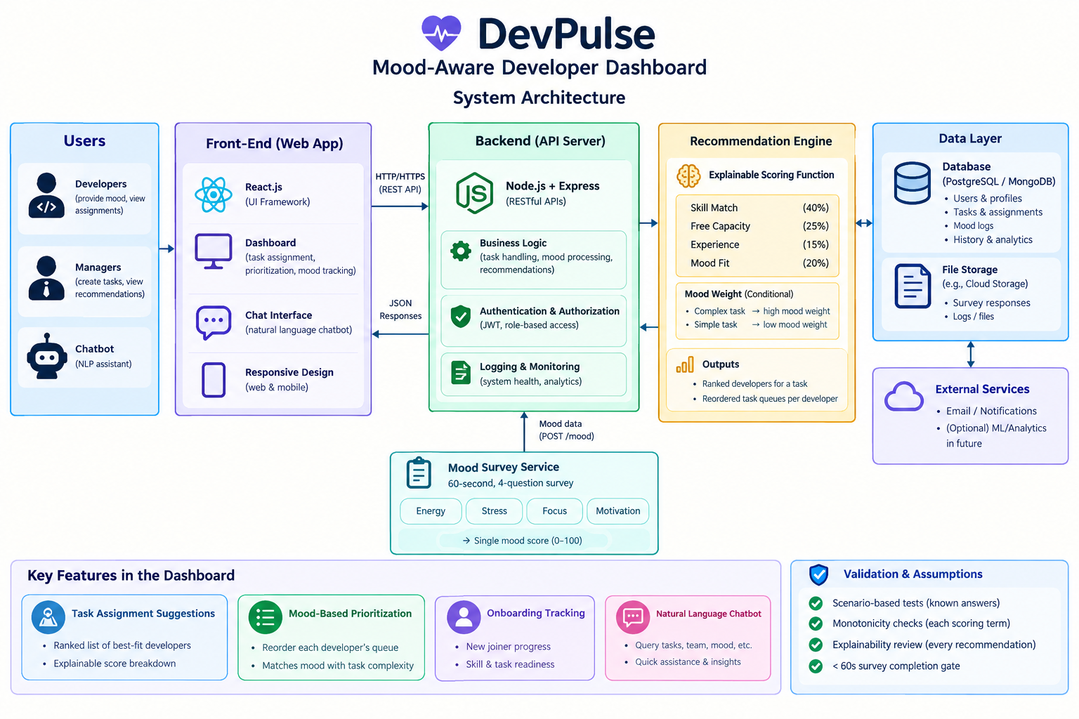
System Architecture
6

Slide 7
Methodology Adopted
1. Requirement Analysis – identify HR, onboarding, task and employee-well-being needs.
2. System Design – divide the application into employee, task, onboarding, mood and assistant modules.
3. Database Development – create relational models using Flask-SQLAlchemy with SQLite.
4. Backend Development – implement Flask routes, data operations and business logic.
5. Frontend Development – build the interactive React dashboard with Tailwind CSS.
6. Module Integration – connect UI actions to backend APIs and database operations.
7. Testing & Validation – verify task, onboarding, mood and employee workflows.
8. Deployment/Execution – run the Flask application locally on port 5000.
7

Slide 8
Technologies Used
Technology | Purpose
Python | Backend programming and application logic
Flask | Web framework and API endpoints
Flask-SQLAlchemy | ORM and database interaction
SQLite | Local relational data storage
React 18 | Interactive frontend dashboard
JavaScript | Frontend logic and API interaction
Tailwind CSS | UI styling and responsive layout
HTML5 / REST-style JSON | Page structure and frontend-backend communication
8

Slide 9
Technical Soundness
Architecture: Single-file Flask REST API + SQLite/SQLAlchemy ORM + React SPA. Clean separation via JSON endpoints; ORM schema is 1:1 portable to PostgreSQL.
Algorithm: Explainable linear ranker — skill match (40), free capacity (25), experience capped at 5 yrs (15), mood fit (20). Mood collapsed from 4 Likert inputs into a bounded 0–100 score; mood term is conditioned on task size (complex tasks prefer high mood, simple tasks accept low mood).
Validation: Unit checks on each scoring term (bounds + monotonicity), 6 scenario tests with known correct ranks, explainability review of every recommendation, chatbot cross-check, and a sub-60-second survey friction gate.
Engineering: Deterministic side-effect-free scoring, single source of truth shared by API and chatbot, transactional writes, idempotent init endpoints, zero external secrets.
Honest scope: No labeled ground truth exists → positioned as an explainable heuristic ranker, not a trained model. Weights are tunable and the API contract allows swapping in a learned ranker without frontend changes.
10

Slide 10
Results / Expected Output
Centralized dashboard for employee and HR operations.
Clear visibility into employee workload and assigned tasks.
Trackable onboarding progress for each employee.
Employee mood information available through structured surveys.
Task recommendations based on employee/project information.
Chatbot provides quick access to frequently requested HR/project information.
12

Slide 11
Future Scope
Add candidate recruitment and application tracking features.
Integrate resume upload and candidate profile management.
Add interview scheduling and recruitment pipeline stages.
Add authentication and role-based access for HR, managers and employees.
Connect with email/calendar services for onboarding notifications.
Add analytics dashboards for HR metrics and onboarding trends.
Deploy the system with a production database and cloud hosting.
13

Slide 12

Thank You

